Slide 1
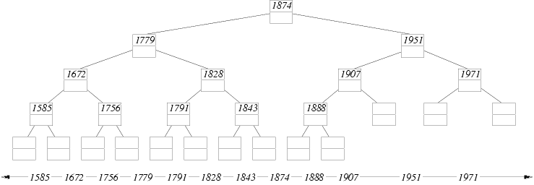


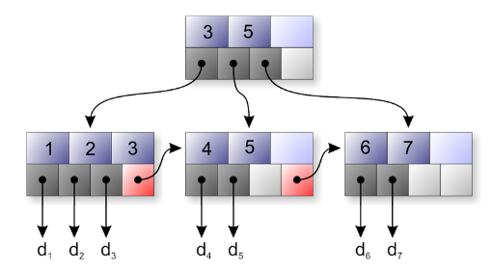

Advanced Data Structures
Wintellect Power Collections, C5 Collections

Slide 2

Table of Contents
Standard .NET Data Structures
Special .NET Collections
Wintellect Power Collections
Installation
Power Collection Classes
Implementing Priority Queue
C5 Collections
Other Advanced Data Structures
Suffix trees, interval trees, ropes, tries, etc.

Slide 3
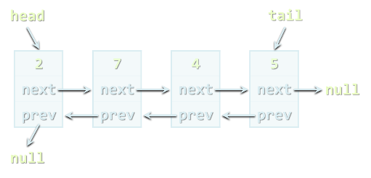
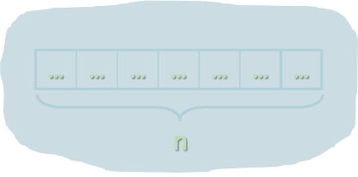
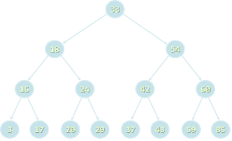
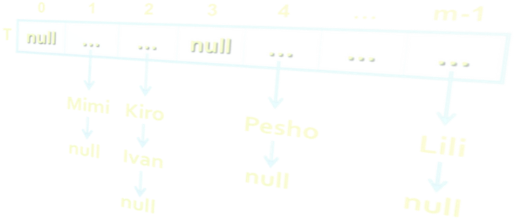
Standard .NET Data Structures
Built-In .NET Data Structure Implementations

Slide 4



.NET Data Structures
Linear structures
Lists: List<T>, LinkedList<T>
Stacks: Stack<T>
Queues: Queue<T>
Dictionaries (maps)
Dictionary<K,V>, SortedDictionary<K,V>
No standard multi-dictionary .NET class
Balanced search tree structures
SortedSet<T>, SortedDictionary<K,V>

Slide 5


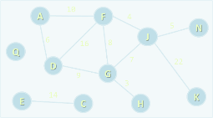
.NET Data Structures (2)
Sets and bags
Sets – HashSet<T>, SortedSet<T>
Bag – no standard .NET class
Ordered sets, bags and dictionaries
Priority queues / heaps → no
Special tree structures → no
Suffix tree, interval tree, index tree, trie
Graphs → no
Directed / undirected, weighted / un-weighted, connected/ non-connected, …

Slide 6
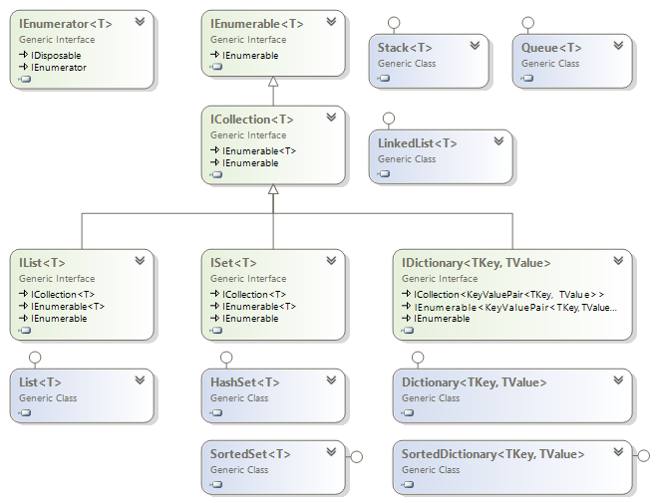
.NET Generic Collections

Slide 7
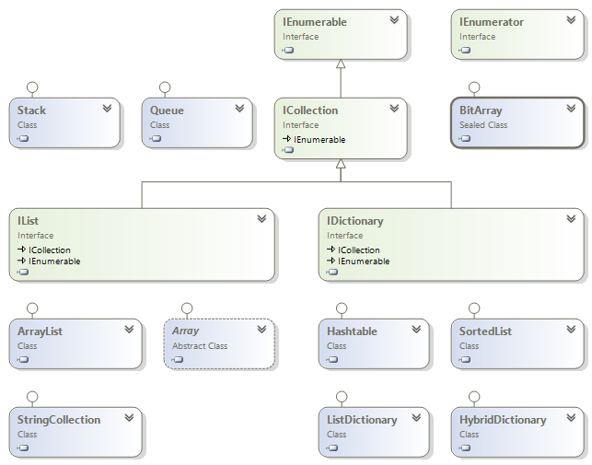
.NET Untyped Collections

Slide 8
Special .NET Collections
Collection<T>
Inheritable IList<T>, virtual Add() / Remove()
ObservableCollection<T>
Event CollectionChanged
IReadOnlyCollection<T>
Supports only Count and GetEnumerator()
IReadOnlyList<T>
Supports only Count, [] and GetEnumerator()
Concurrent collections (thread-safe)
BlockingCollection<T>, ConcurrentBag<T>, …

Slide 9

Special .NET Collections
Live Demo

Slide 10

Wintellect Power Collections
Open Source C# Implementation of All Major Data Structures: Lists, Sets, Bags, Dictionaries, etc.

Slide 11
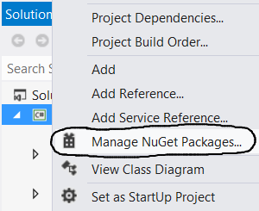
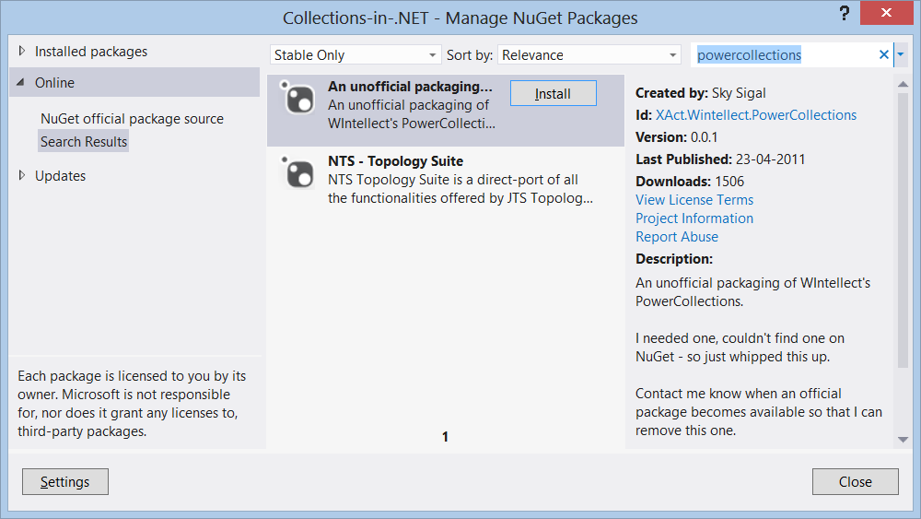
Wintellect Power Collections
Wintellect Power Collections is powerful open-source data structure library
Download: http://powercollections.codeplex.com
Installing Power Collections in Visual Studio
Use NuGet package manager

Slide 12

Power Collections Classes
Bag<T>
A bag (multi-set) based on hash-table
Unordered collection (with duplicates)
Add / Find / Remove work in time O(1)
T should provide Equals() and GetHashCode()
OrderedBag<T>
A bag (multi-set) based on balanced search tree
Add / Find / Remove work in time O(log(N))
T should implement IComparable<T>

Slide 13

Power Collections Classes (2)
Set<T>
A set based on hash-table (no duplicates)
Add / Find / Remove work in time O(1)
Like .NET’s HashSet<T>
OrderedSet<T>
A set based on balanced search tree (red-black)
Add / Find / Remove work in time O(log(N))
Like .NET’s SortedSet<T>
Provides fast .Range(from, to) operation

Slide 14

Power Collections Classes (3)
MultiDictionary<TKey, TValue>
A dictionary (map) implemented by hash-table
Allows duplicates (configurable)
Add / Find / Remove work in time O(1)
Like Dictionary<TKey, List<TValue>>
OrderedDictionary<TKey, TValue> / OrderedMultiDictionary<TKey, TValue>
A dictionary based on balanced search tree
Add / Find / Remove work in time O(log(N))
Provides fast .Range(from, to) operation

Slide 15

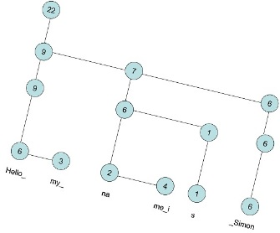
Power Collections Classes (4)
Deque<T>
Double-ended queue (deque)
BigList<T>
Editable sequence of indexed items
Like List<T> but provides
Fast Insert / Delete operations (at any position)
Fast Copy / Concat / Sub-range operations
Implemented by the data structure "Rope"
Special kind of balanced binary tree: http://en.wikipedia.org/wiki/Rope_(data_structure)

Slide 16
Wintellect Power Collections
Live Demo

Slide 17

Priority Queue
What is a "priority queue"?
Data structure to efficiently support finding the item with the highest priority
Like a queue, but with priorities
The basic operations
Enqueue(T element)
Dequeue() → T
There is no build-in priority queue in .NET
See the data structure "binary heap"
Can be implemented also by OrderedBag<T>

Slide 18

Priority Queue Implementation
class PriorityQueue<T> where T : IComparable<T>
{
private OrderedBag<T> queue;
public int Count
{
get { return this.queue.Count; }
}
public PriorityQueue()
{
this.queue = new OrderedBag<T>();
}
public void Enqueue(T element)
{
this.queue.Add(element);
}
public T Dequeue()
{
return this.queue.RemoveFirst();
}
}

Slide 19
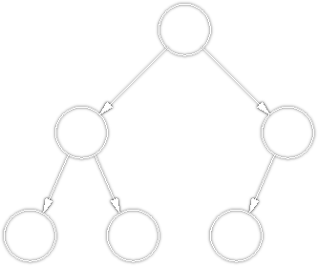
Priority Queue
Live Demo

Slide 20
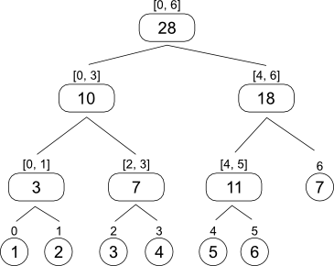
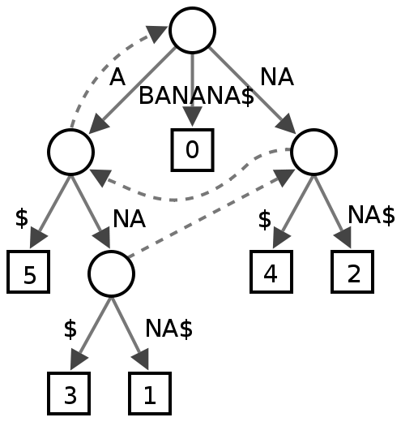
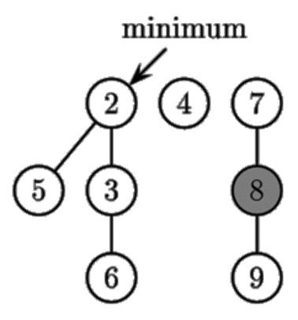
Advanced Data Structures
Suffix Trees, Interval Trees, Tries, Ropes, Heaps, …

Slide 21
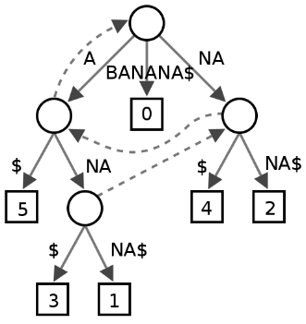
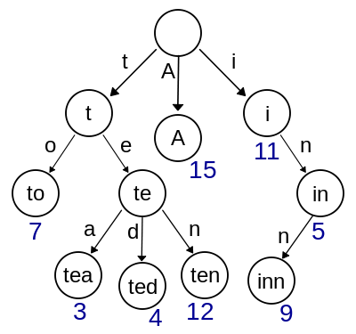
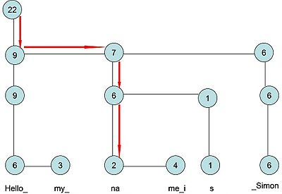
Advanced Data Structures
Suffix tree (position tree)
Represents the suffixes of given string
Used to implement fast search in string
Trie (prefix tree)
Special tree structure used for fast multi-pattern matching
Rope
Balanced tree structure for indexed items with fast inserts / delete
Allows fast string edit operations

Slide 22
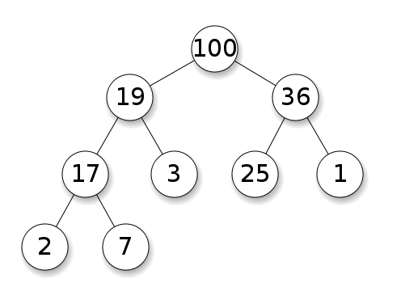
Advanced Data Structures (2)
Interval tree
Keeps intervals [a…b] in ordered balanced tree
Allows to efficiently find all intervals that overlap with any given interval or point
Binary heap, Fibonacci heap
Special tree-like data structures to efficiently implement a priority queue
Index trees
Used to keep sorted indices of database records
B-tree, B+ tree, T-tree

Slide 23
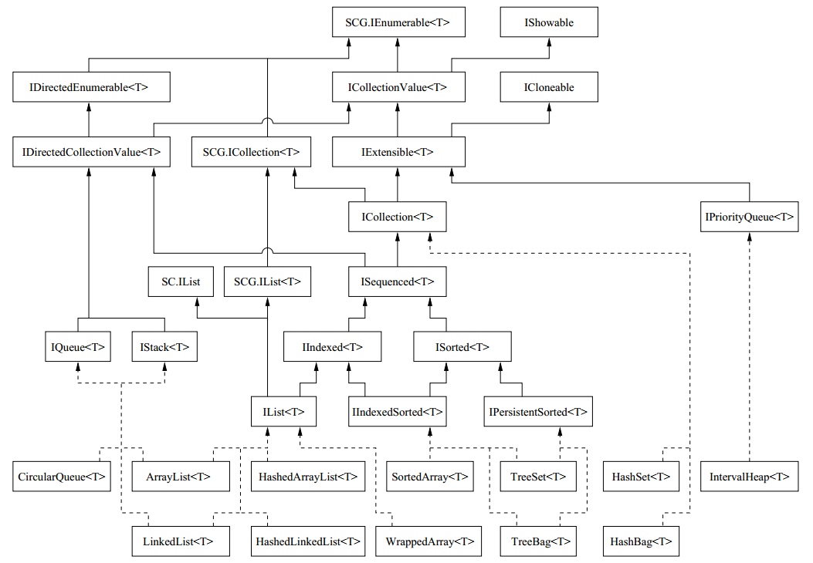
C5 Collections
Open Source Generic Collection Library for C#

Slide 24
C5 Collections
What are "C5 Collections"?
C5 Generic Collection Library for C# and CLI
Open-Source Data Structures Library for .NET
http://www.itu.dk/research/c5/
Have solid documentation (book) – http://www. itu.dk/research/c5/latest/ITU-TR-2006-76.pdf
The C5 library defines its own interfaces like IEnumerable<T>, IIndexed<T>, IIndexedSorted<T>, etc.

Slide 25
C5 Collection Classes

Slide 26
C5 Collection Classes
Classical collection classes
ArrayList<T>, LinkedList<T>, CircularQueue<T>, HashSet<T>, TreeSet<T>, HashBag<T>, TreeBag<T>
HashedArrayList<T>
Combination of indexed list + hash-table
Fast Add / Find / indexer [] → O(1)
IntervalHeap<T>
Efficient double-ended priority queue

Slide 27

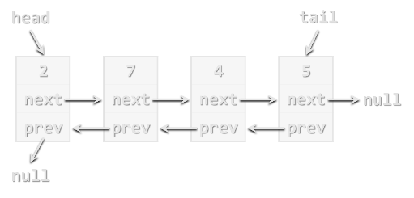
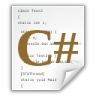
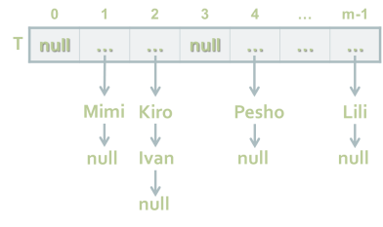
Advanced Data Structures
http://academy.telerik.com

Slide 28
Exercises
Implement a class PriorityQueue<T> based on the data structure "binary heap".
Write a program to read a large collection of products (name + price) and efficiently find the first 20 products in the price range [a…b]. Test for 500 000 products and 10 000 price searches.
Hint: you may use OrderedBag<T> and sub-ranges.
Write a program that finds a set of words (e.g. 1000 words) in a large text (e.g. 100 MB text file). Print how many times each word occurs in the text.
Hint: you may find a C# trie in Internet.

Slide 29
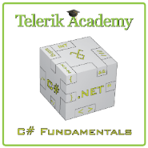



Free Trainings @ Telerik Academy
C# Programming @ Telerik Academy
csharpfundamentals.telerik.com
Telerik Software Academy
academy.telerik.com
Telerik Academy @ Facebook
facebook.com/TelerikAcademy
Telerik Software Academy Forums
forums.academy.telerik.com

